Slide 1


Slide 2











-
-
-
•
•
•

Slide 3



Driver
A
Java
Application
Driver B
JDBC
Driver
C

Slide 4

Driver
Manager
Driver
Connection
Prepared Statement
Statement
ResultSet

Slide 5
Driver
Manager
Driver
Connection
Prepared Statement
Statement
ResultSet

Slide 6
Driver
Manager
Driver
Connection
Prepared Statement
Statement
ResultSet

Slide 7
Driver
Manager
Driver
Connection
Prepared Statement
Statement
ResultSet

Slide 8
Driver
Manager
Driver
Connection
Prepared Statement
Statement
ResultSet

Slide 9
Driver
Manager
Driver
Connection
Prepared Statement
Statement
ResultSet

Slide 10








Slide 11



Slide 12


Slide 13





Slide 14
























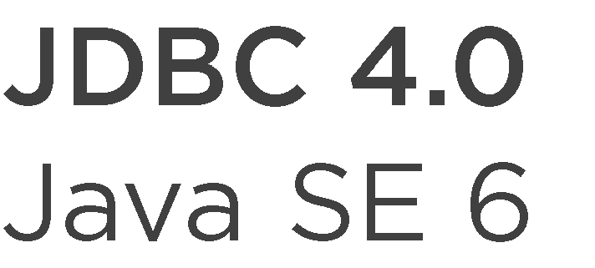






Slide 15



Slide 16





-
-
-

Slide 18
DataSource
DriverManager
Driver
Connection
Prepared Statement
Statement
ResultSet

Slide 19



Slide 20



Slide 21


Slide 22



-
-
-
-

